Slide 1
PC Maintenance: Preparing for A+ Certification
Chapter 18: Working with Printers

Slide 2
Chapter 18 Objectives
Identify basic printer functions
Distinguish between classes of printers
Explain printer technologies
Explain the laser printing process
Install and manage printer drivers in Windows
View and install Windows fonts
Troubleshoot printer problems

Slide 3
Basic Printing Functions
Receive data from the PC through an I/O interface
Store the data in printer RAM
Convert the data into print instructions
Feed the paper in and out
Store and dispense ink or toner
Transfer the image onto the paper

Slide 4
Line Printer
Print job is still spooling to the printer as the page begins printing
Requires very little RAM of its own
Examples: Ink-jet, dot matrix, daisywheel

Slide 5
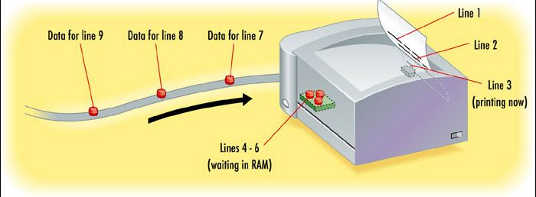
Line Printer

Slide 6
Page Printer
Entire page collects in printer RAM, then is transferred to the paper
Requires more RAM than a line printer because it must hold more data at a time
Examples: Laser, LED

Slide 7
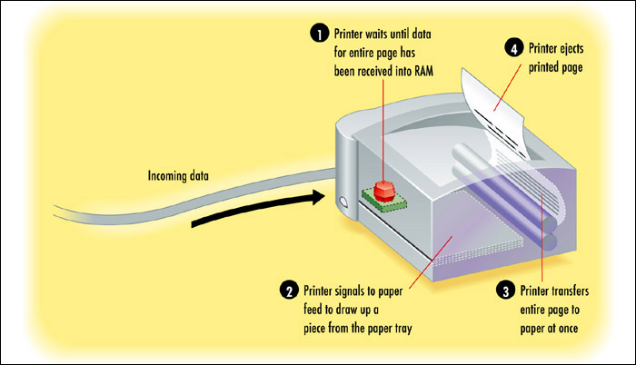
Page Printer

Slide 8
Ink or Toner
Liquid ink: Sprayed onto paper
Dry toner: Transferred to paper with electrical charge and then fused (melted) to the paper with heat
Inked ribbon: Pins or hammers strike the ribbon, leaving a mark on the paper behind it

Slide 9
Impact and Non-Impact
Impact printer strikes a ribbon physically. Only an impact printer is able to print on multi-part forms (such as carbon paper)
  Inkjet, Daisywheel
Non-impact printer does not use physical force to place the image on the page. Multiple copies must be printed individually.
  Laser, inkjet, LED, thermal wax transfer

Slide 10
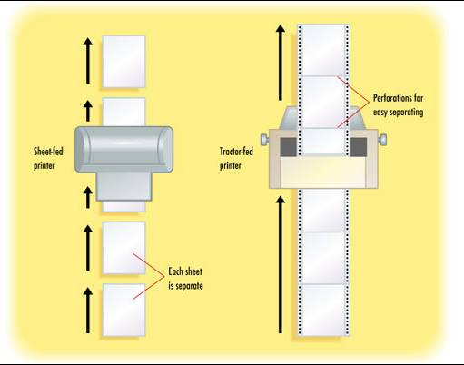
Paper Feed Type
Tractor-fed (continuous)
Sheet-fed

Slide 11
Factors for Evaluating Printers
Initial cost
Cost of supplies
  Ink, toner, special paper
Speed
  Delay before printing starts
  Pages per minute

Slide 12
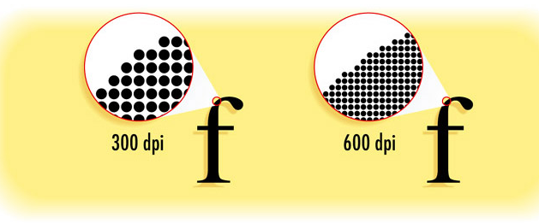
Factors for Evaluating Printers
Print quality
  Measured in dots per inch (dpi)

Slide 13
Factors for Evaluating Printers
Interface
  Parallel, USB, network
Paper tray
  Number of sheets of input, output
Paper feed type (tractor-fed, sheet-fed)
Extra RAM
Page description language (PDL)

Slide 14
Types of Printer Technology
Daisywheel (obsolete)
Dot Matrix
Inkjet
Laser
LED
Dye Sublimation
Solid Ink

Slide 15
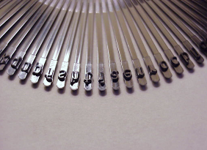
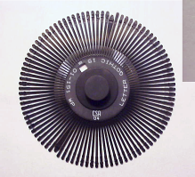
Daisywheel
Earliest type of printer, now long obsolete
Rotating wheel containing all the characters for a font
Tractor-fed
Impact
Inked ribbon
Single-color
Line printer

Slide 16
Dot Matrix
Improved on daisywheel by making multiple fonts possible
Letters formed by metal pins
Inked ribbon
Tractor-fed
Impact
Single-color
Line printer

Slide 17
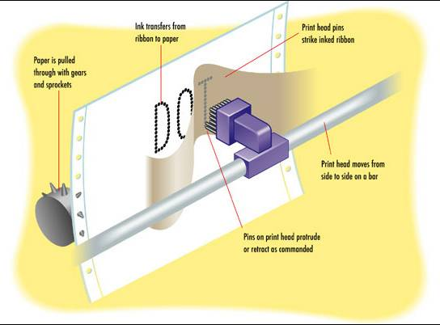
Dot Matrix

Slide 18
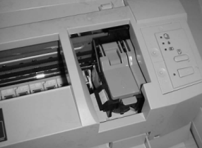
Inkjet
Liquid ink dispensed by nozzles in the print head
  Thermal (bubble jet)
  Piezoelectric
Sheet-fed
Non-impact
Multi-color
Line printer

Slide 19
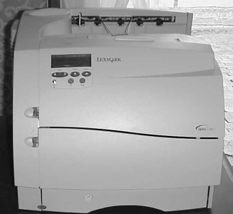
Laser
Solid toner dispensed by electrical charges
Sheet-fed
Non-impact
Single-color or
multi-color
Page printer

Slide 20
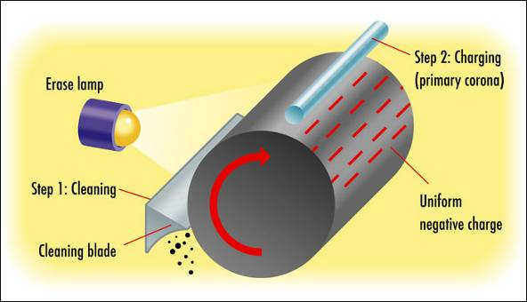
Laser Printing Process
Step 1: Cleaning
Step 2: Charging (Conditioning)

Slide 21
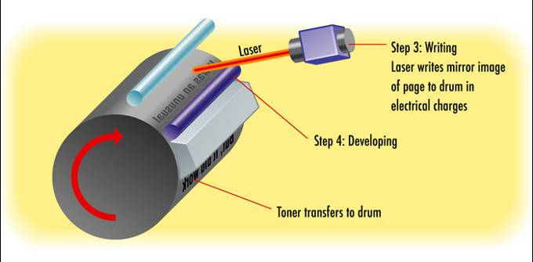
Laser Printing Process
Step 3: Writing
Step 4: Developing

Slide 22
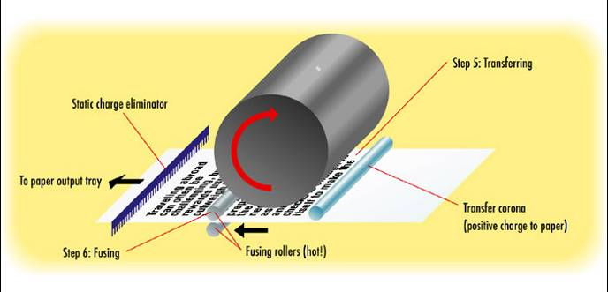
Laser Printing Process
Step 5: Transferring
Step 6: Fusing

Slide 23
Summary of Types
 | Dot Matrix | Inkjet | Laser
Ink | Ribbon | Liquid | Toner
Paper feed | Tractor-fed | Sheet-fed | Sheet-fed
Line or Page | Line | Line | Page
Impact or Non-Impact | Impact | Non-impact | Non-impact
Color | No | Yes | Some

Slide 24
Printer Interfaces
Legacy Parallel
  SPP (Standard Parallel Port)
  Bidirectional
  EPP
  ECP
USB
Network
Infrared (rare)
Legacy serial (obsolete)

Slide 25
Printer Drivers
Page Description Languages (PDLs) translate between PC and printer
Popular PDLs include:
  Printer Control Panguage (PCL), developed by HP for laser printers
  PostScript, developed by Adobe for professional typesetting

Slide 26
Installing a Printer Driver in Windows
Windows refers to a driver as a “printer”
You can have more than one driver installed for the same printer, resulting in multiple “printers” in Windows for a single physical unit

Slide 27
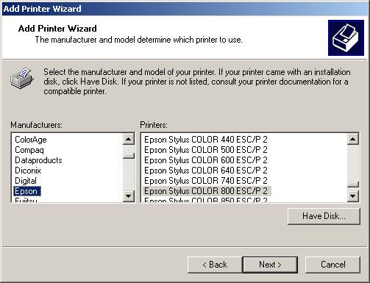
Installing a Printer Driver in Windows
Run the Add Printer Wizard
  Let Windows detect the printer, or
  Choose from a list

Slide 28
Printer Driver Maintenance
Remove a Printer
  Delete its icon from the Printers (or Printers and Faxes) folder
Set Default Printer
  Right-click icon and choose Set as Default
View Driver Properties
  Right-click icon and choose Properties

Slide 29
Laser Printer Maintenance
Wipe out the inside
Run printer’s cleaning sequence
Adjust toner delivery
Change toner cartridge
Change cleaning pad
Clean corona wires
Replace drum

Slide 30
Inkjet Printer Maintenance
Change ink cartridges
Run printer’s cleaning sequence

Slide 31
Fonts and Typefaces
Resident fonts: built into the printer
  Built-in fonts: Fonts that come with the printer
  Cartridge fonts: Fonts added to the printer via a cartridge plugged into it (rare)
Soft fonts: files in Windows
  Screen fonts: Fonts for displaying onscreen
  Printer fonts: Fonts for sending to the printer

Slide 32
Fonts and Typefaces
Outline fonts
  Scaleable to any size
  Each letter is an outline that can be enlarged or shrunk and then filled in
  TrueType, OpenType
Bitmap fonts
  Available only in a limited set of sizes
  Each letter is a fully formed graphic

Slide 33
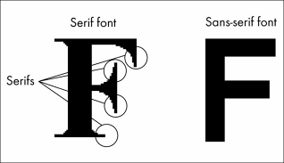
Fonts and Typefaces
Serif fonts: Tails on letters
  Easier to read in body text
  Look better in small sizes
  More formal look
Sans-serif fonts: Plain letters
  Easier to read in headings
  Look better in large sizes
  More casual look

Slide 34
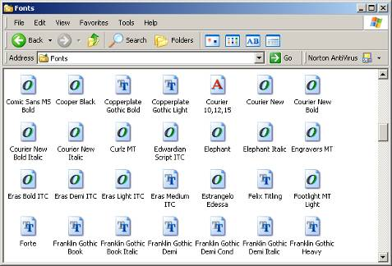
View Installed Fonts in Windows
Open Fonts window
Double-click a font to see a sample of it in detail
A indicates bitmap font
O indicates OpenType
T indicates TrueType

Slide 35
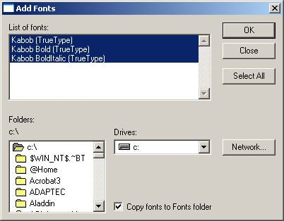
Install New Fonts in Windows
Open Fonts folder
Choose File > Install New Font

Slide 36
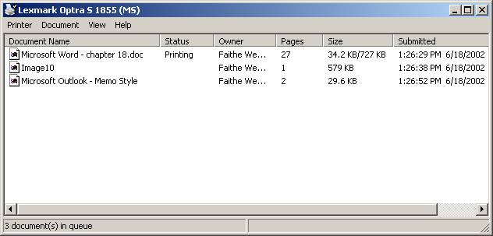
Print Queue
View print queue
  Double-click printer icon in Printers folder

Slide 37
Managing a Print Queue
Pause print queue
  Printer > Pause Printing
Clear print queue
  Printer > Cancel All Documents
Pause an individual print job
  Document > Pause
Cancel an individual print job
  Document > Cancel, or press Delete

Slide 38
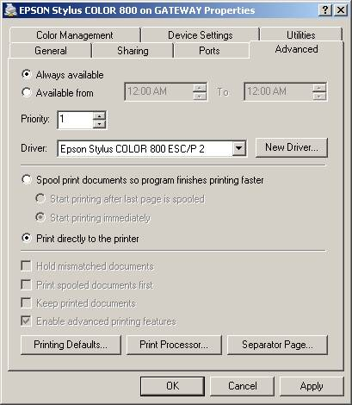
Managing a Print Queue
Disable the print queue
  View printer’s Properties box, click Advanced tab, choose Print Directly to the Printer

Slide 39
Troubleshooting Printing Problems
Stalled queue
  Pause and resume queue after deleting job with error
Junk characters in printout
  Power printer off
  Clear queue
  Power printer on and try again
  If problem persists, reinstall driver

Slide 40
Troubleshooting Printing Problems
Paper jams
  Fan paper before inserting in tray
  Check feed rollers
  Check for obstructions inside printer (ex. bits of paper)
  Use different weight of paper

Slide 41
Troubleshooting Printing Problems
Illegal operation or general protection fault
  Pause and resume print queue
  Restart computer
  Remove and reinstall printer driver

Slide 42
Laser Quality Problems
Printout faint in some spots
  Shake toner cartridge gently
  Replace toner cartridge
Loose or smeared toner
  Check fuser
Vertical white streaks
  Dirty corona wires

Slide 43
Laser Quality Problems
Gray mist
  Dirty corona wires
  Print density set too high
  Drum needs replacing
Horizontal black lines
  Dirty or damaged roller
Regularly spaced splotches
  Scratched or dirty drum

Slide 44
Laser Quality Problems
All-white page
  Transfer corona broken
  Printer is completely out of toner
All-black page
  Primary corona broken
  Drum not holding a charge

Slide 45
Inkjet Quality Problems
Stripes, or one color missing
  Clean ink jets using printer’s utility
  Run printer’s self-test
Colors off alignment
  Run printer’s alignment utility

Slide 46
Dot-Matrix Quality Problems
Flecks and smudges
  Ribbon is too tight
Faint printing overall
  Ribbon is worn out
Faint printing on one side
  Platen is misaligned
Missing sections of letters
  Pins on print head damaged

